Slide 1
Chapter 21 – Clinical Translation

Slide 2
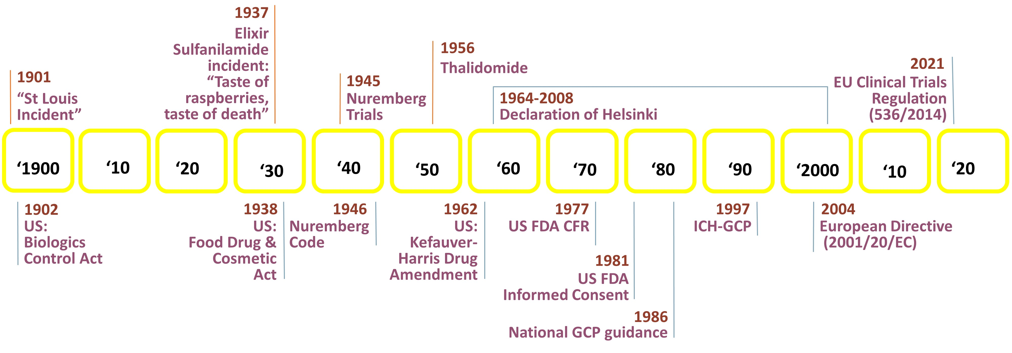
Notes:
Figure 21.1: Historical events leading to today’s regulatory framework.

Slide 3
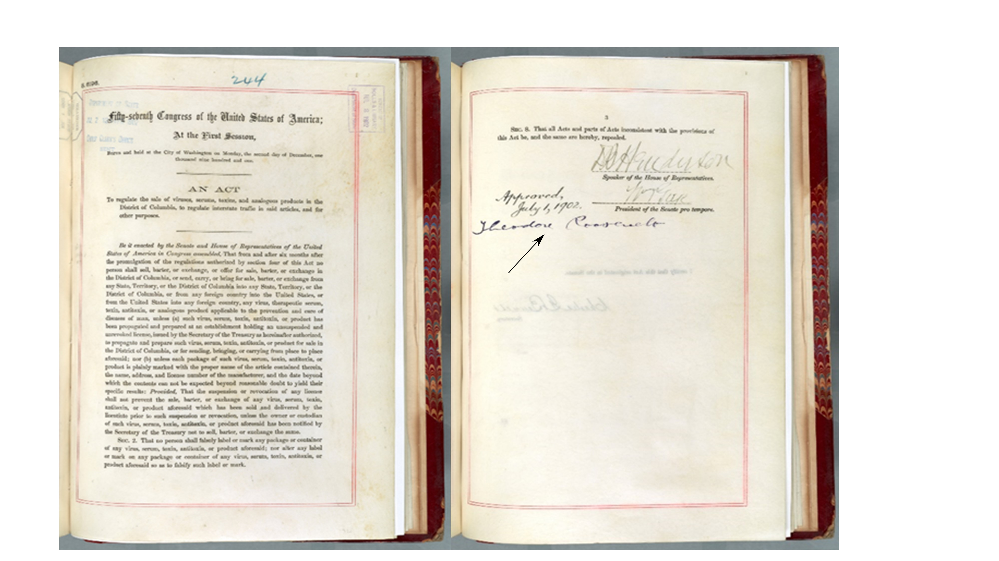
Notes:
Figure 21.2: Biologics Control Act (1902) signed by President Theodore Roosevelt.
Thanks to: Jane Fitzgerald, Archivist, Archives 1 Reference Section, National Archives and Records Administration, Washington, DC.

Slide 4
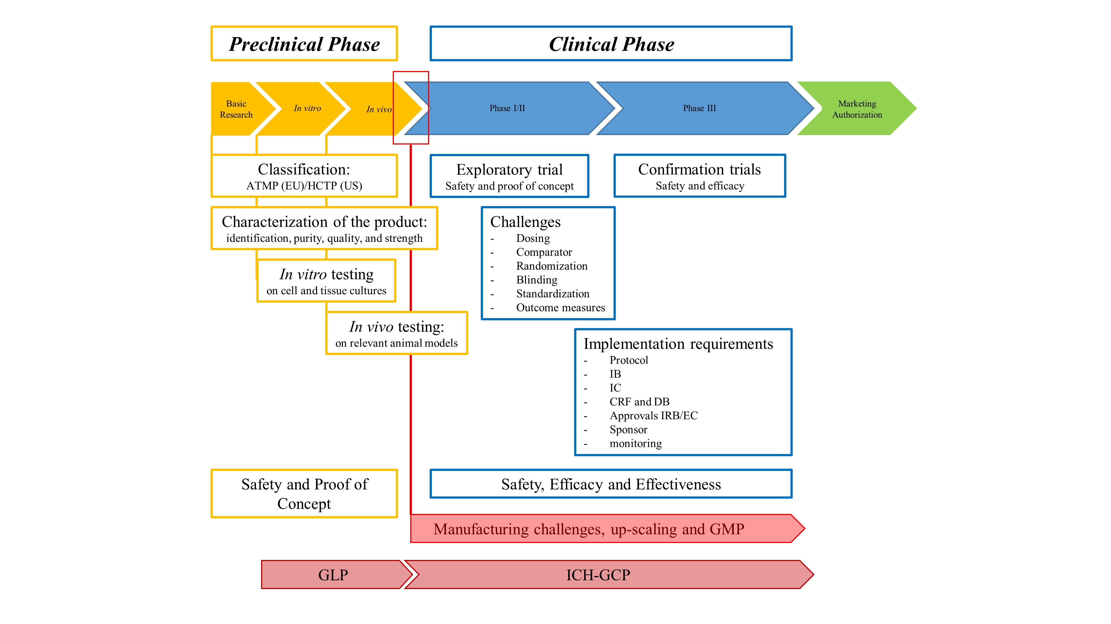
Notes:
Figure 21.3: Schematic overview on the preclinical and clinical development path of tissue engineered products.

Slide 5
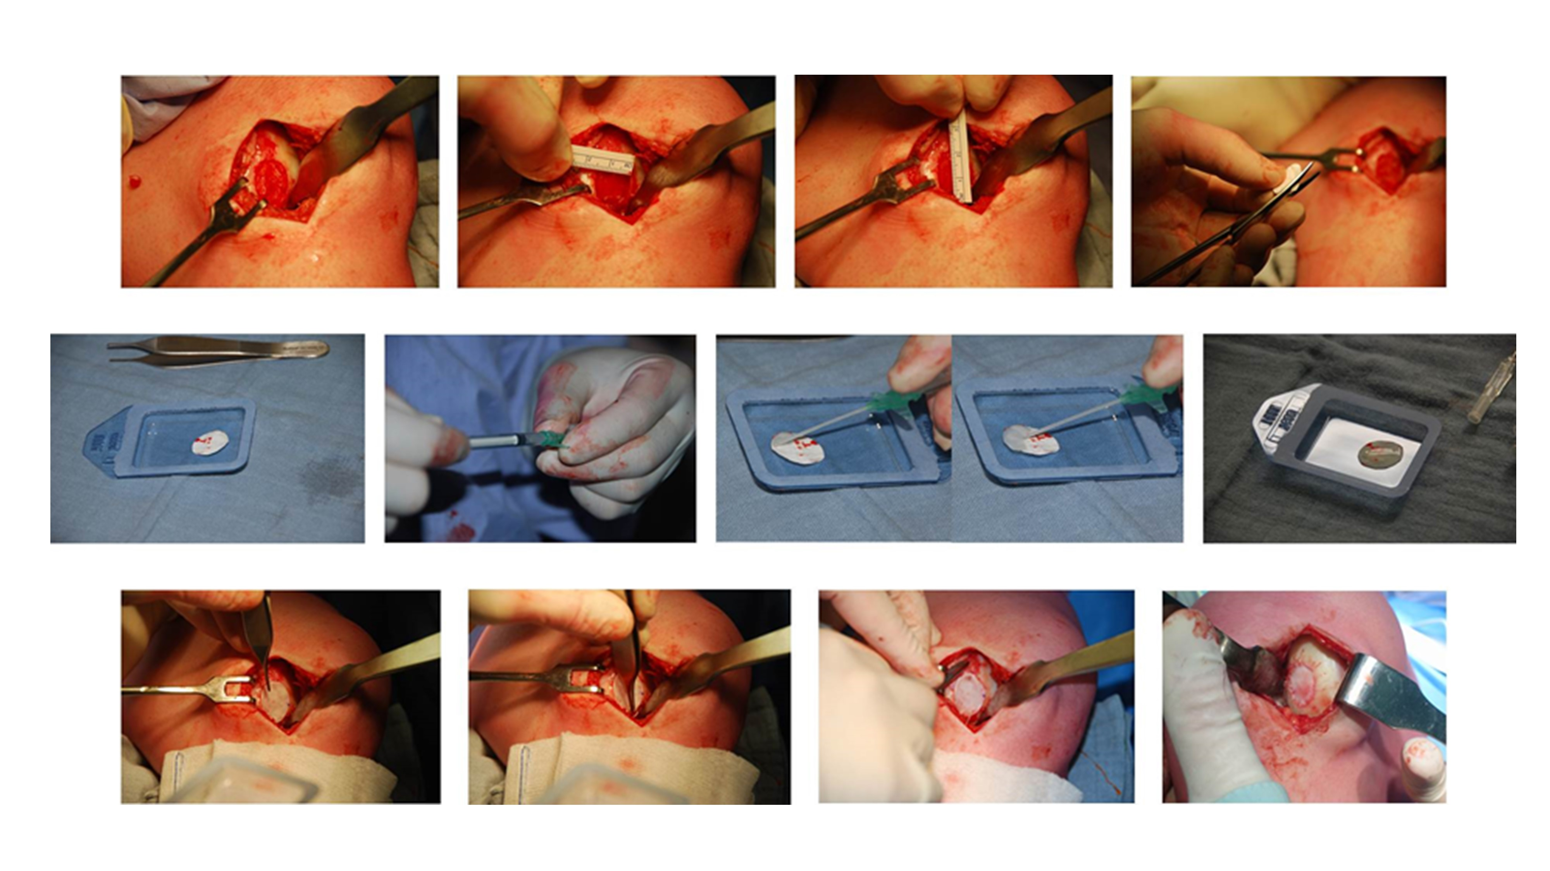
Notes:
Figure 21.4: Example of the complexity of an ATMP/HCTP administration.

Slide 6
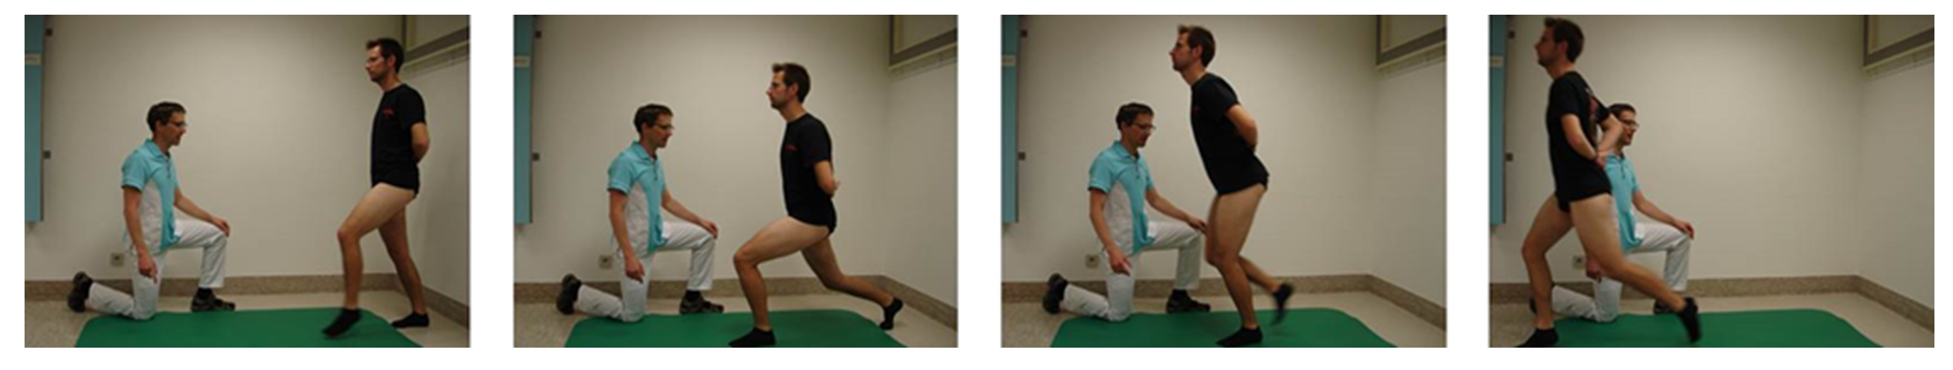
Notes:
Figure 21.5: Physiotherapy as part of a standardized postoperative rehabilitation program is required to optimize wound care and rehabilitation after surgery.

